Slide 1
Wireless 3D Printing
Developers:
Cuong Vuong
Kirolous Frouk
Beesham Sarendranauth

Slide 2
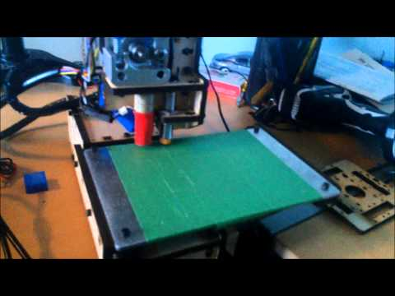
Introduction

Slide 3
Purpose
To find a way to make the process of sending 3D print jobs to a 3D printer without being tethered to a computer.
making it convenient
connecting to multiple printers

Slide 4
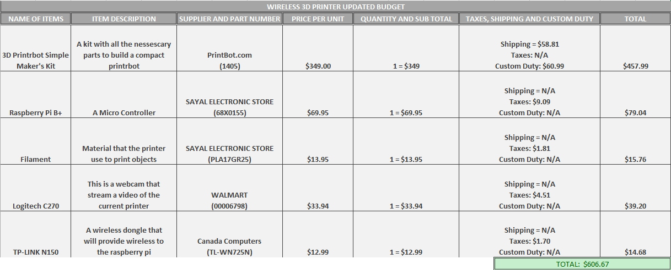
Budget

Slide 5
Schedule/Planning
RaspberryPi B+ setup with 3D printer
Library Gathering
Database Structure
Web Interface
Application Interface

Slide 6
Our process is easy
Web Interface
Mobile App
Server
Printer

Slide 7
Web Interface
Features:
select different printers
current status of the printer (Temperature, Printer State)
upload and see the current files on the printer
send commands to the printer via terminal
viewing different layers of the print with gcode viewer
Manual control of the printer and view the printer via webcam streaming

Slide 8
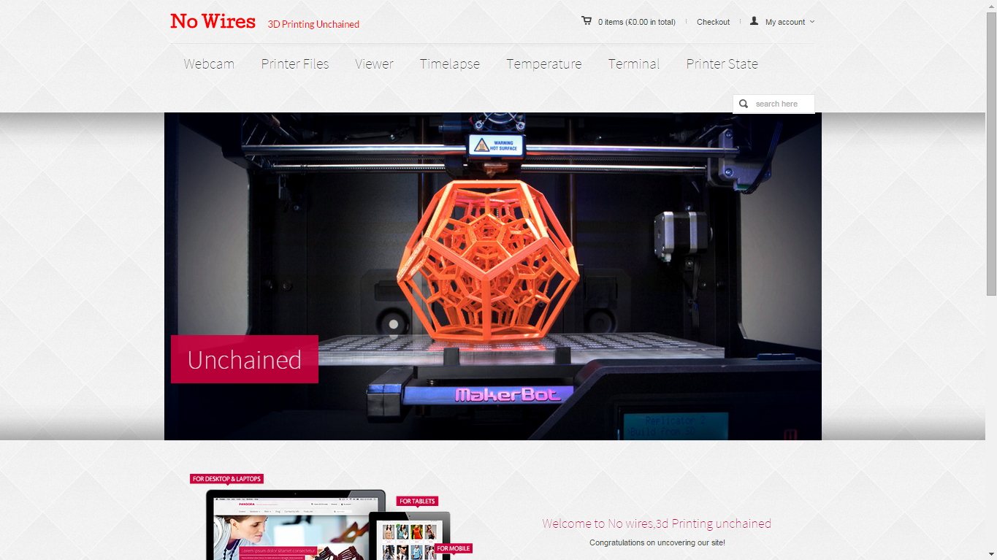
Place your screenshot here
Website Home
Provides a central place to access all tabs

Slide 9
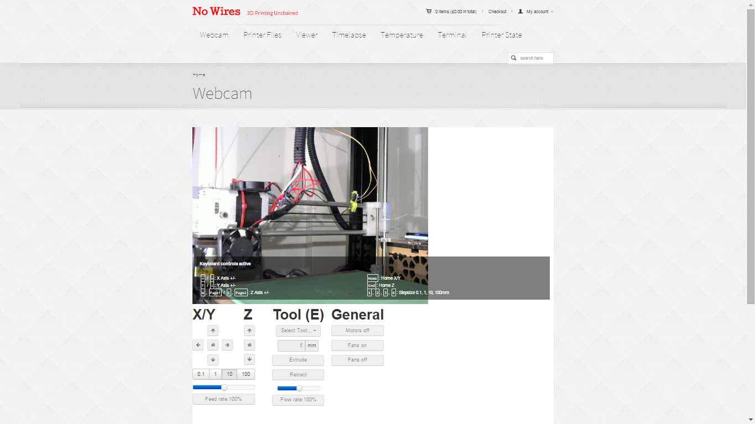
Webcam

Slide 10
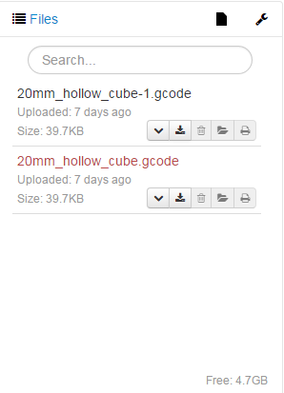
Printer Files

Slide 11
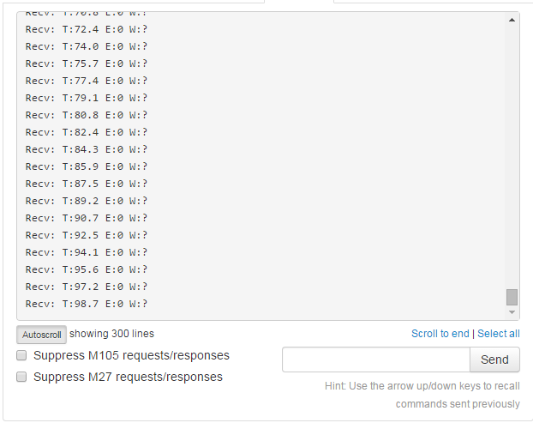
Terminals

Slide 12
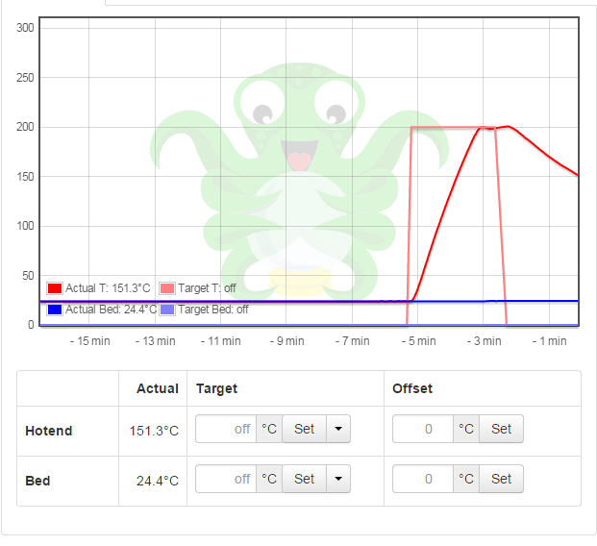
Temperature

Slide 13
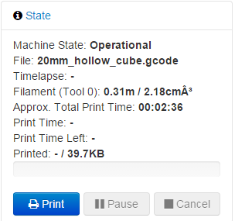
Printer State

Slide 14
Database
Contains the printer informations needed for access
Printer’s Name
IP address
API Key

Slide 15

Mobile Application

Slide 16
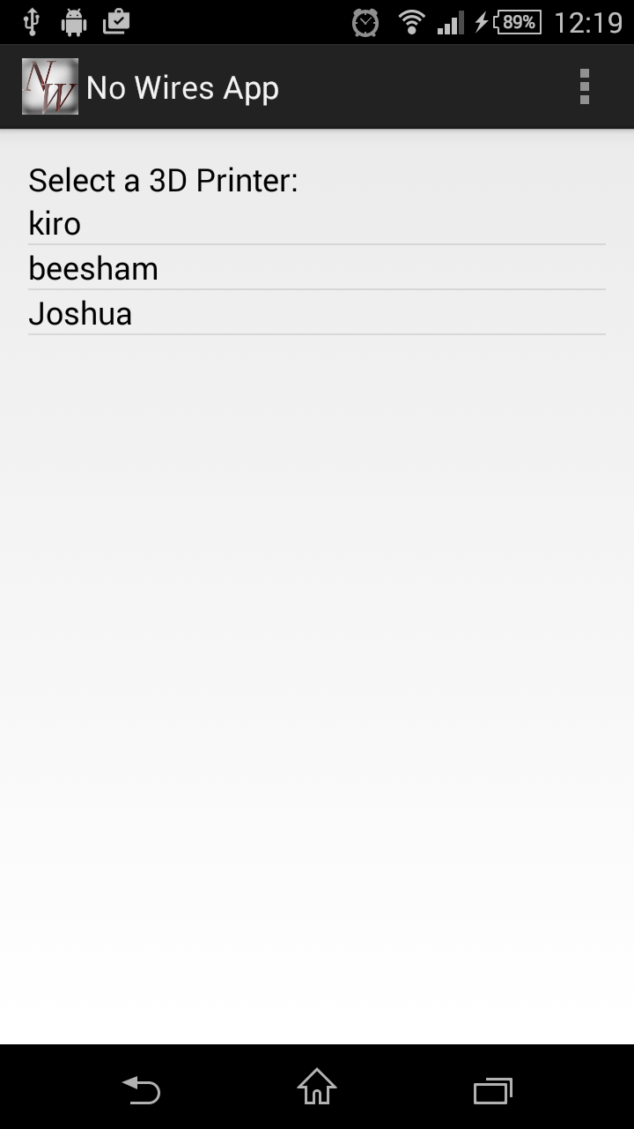
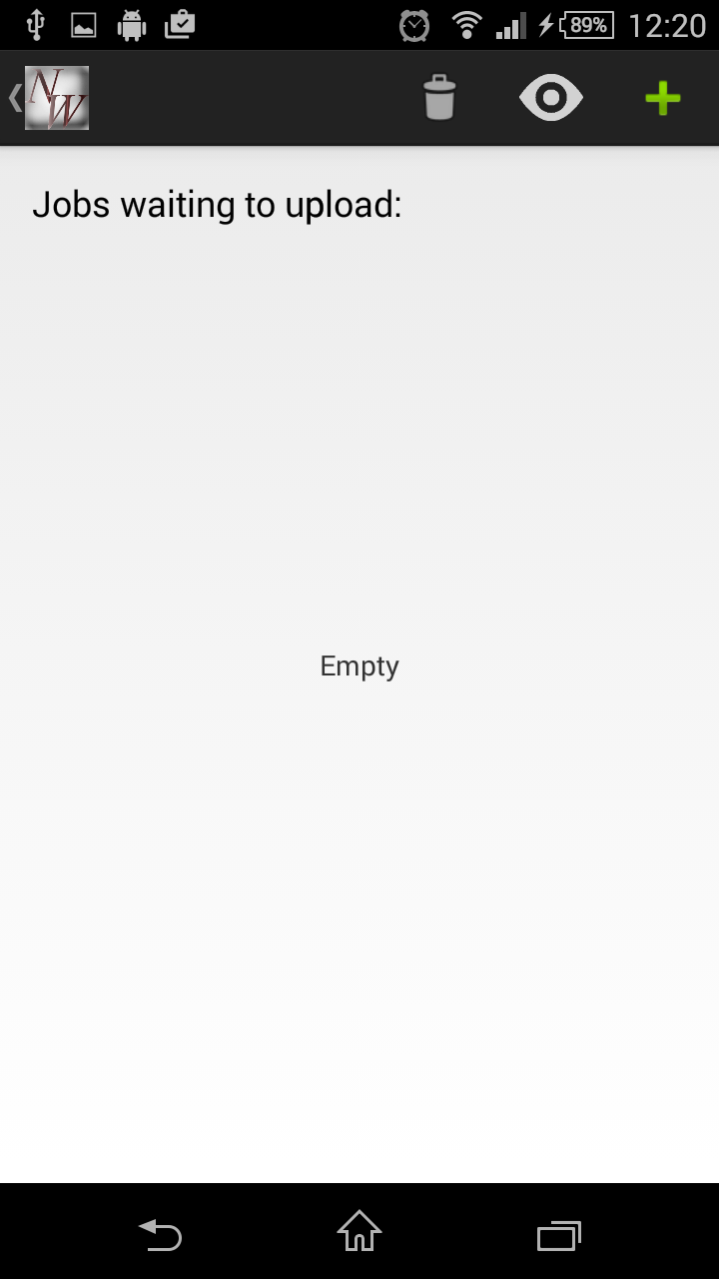
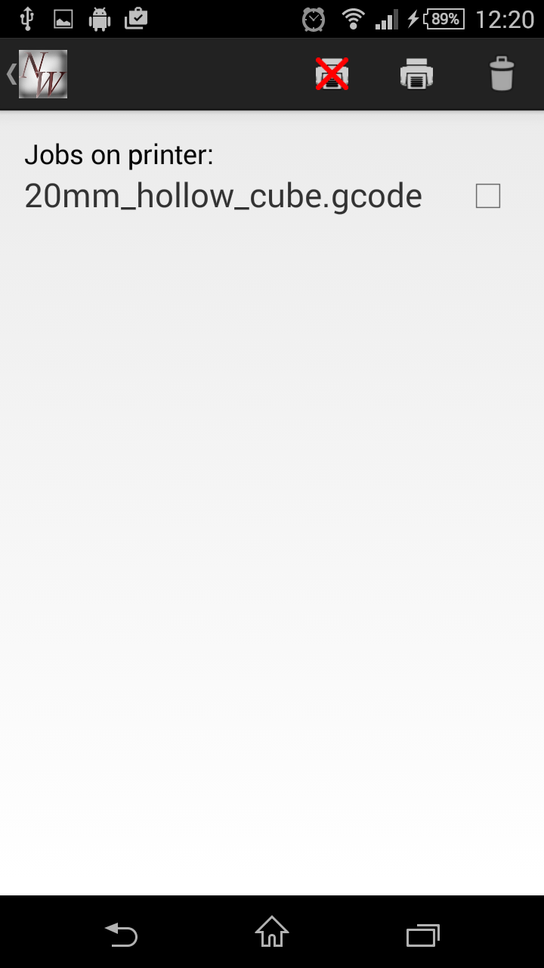

Slide 17
How we eliminated wires?
Connection using the internet through wi-fi!
Upload to local database if no connection
Upload to server otherwise
Http post and get to server

Slide 18
Skills from other courses
CENG515: Hardware Production Technology
CENG302:
Systems Analysis
CENG415:
SQL Database
TECH154:
Unix and the Internet
CENG300: Software Projects
COMM313:
Technical Comm.

Slide 19

Conclusion

Slide 20
Thanks!
Any questions?

Slide 21
SlidesCarnival icons are editable shapes.
This means that you can:
Resize them without losing quality.
Change fill color and opacity.
Change line color, width and style.
Isn’t that nice? :)
Examples:

